Slide 1
Movie-Novels List
By: Nijo Jacob, Nishchala Barde, Natasha Lalwani, Nancy Melucci

Slide 2
Background
A lot of the younger children don’t have the habit of reading books and is bounding to find it difficult reading material given to them by teachers in middle and high school.
Young audience who don’t have time for reading rather choose watching a movies.
School and Librarians selection criteria for young adults and children
Cultural Historians interesting in the alternative choice options
Others who might want to know about sources to encourage reading or understand the differences between the text of a book and the screenplay written to represent the book in movies, television or streaming media.

Slide 3
DataSet
We propose integrating a dataset that utilize both the movies and book dataset together that is available for our targeted audience
We use a kaggle imdb csv file contains information of movies from year 1894 to 2020 about 85855 movies.
The books are retrieved using api calls with google books api which are based on client users created by google. It contains various of books categories,including the volume, authors, filter option such e-books, paid version.
The integrated dataset will provide information about movies and books : title, authors, imdb link to movie homepage, rating of the movies, is the movies based on a novel, country, language, director, book publish date, amount of pages and genre or category.

Slide 4
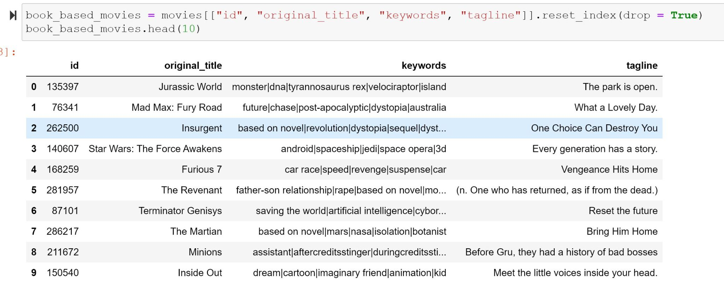
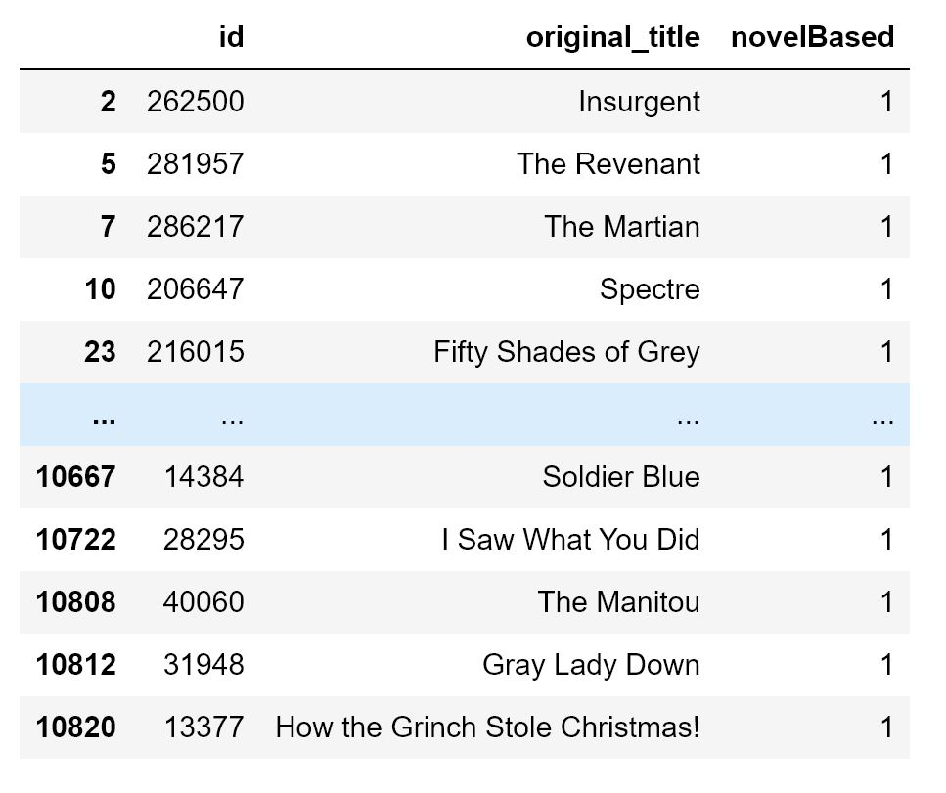
movies.csv Dataset

Slide 5
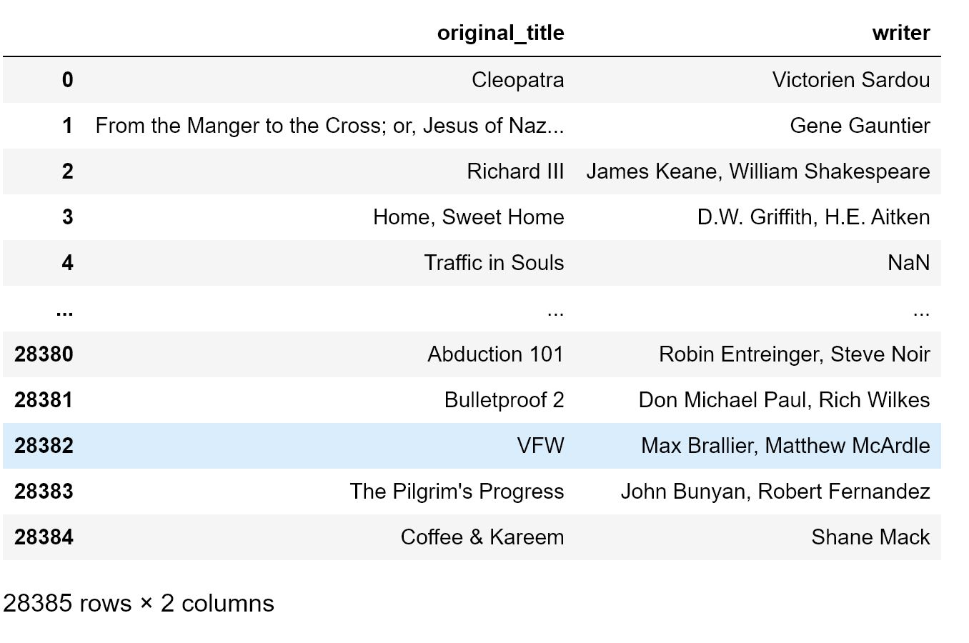
IMDB_movies.csv
Intregrating author field from IMDB_movies.csv and merge it into the movies Dataset.
Checking the language and country column to focus movies created on USA.

Slide 6
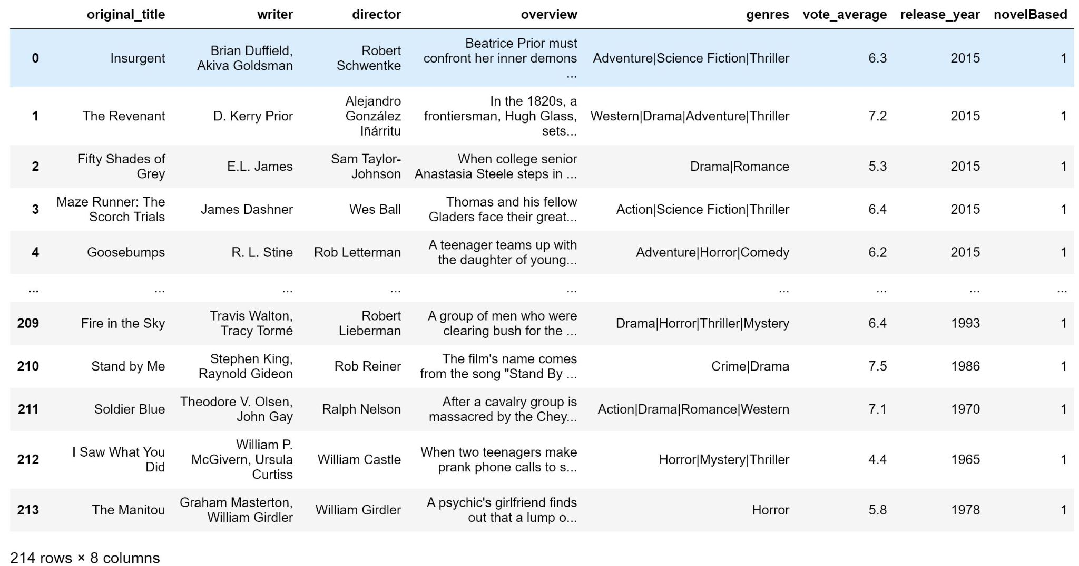
IMDB Movie Dataset

Slide 7
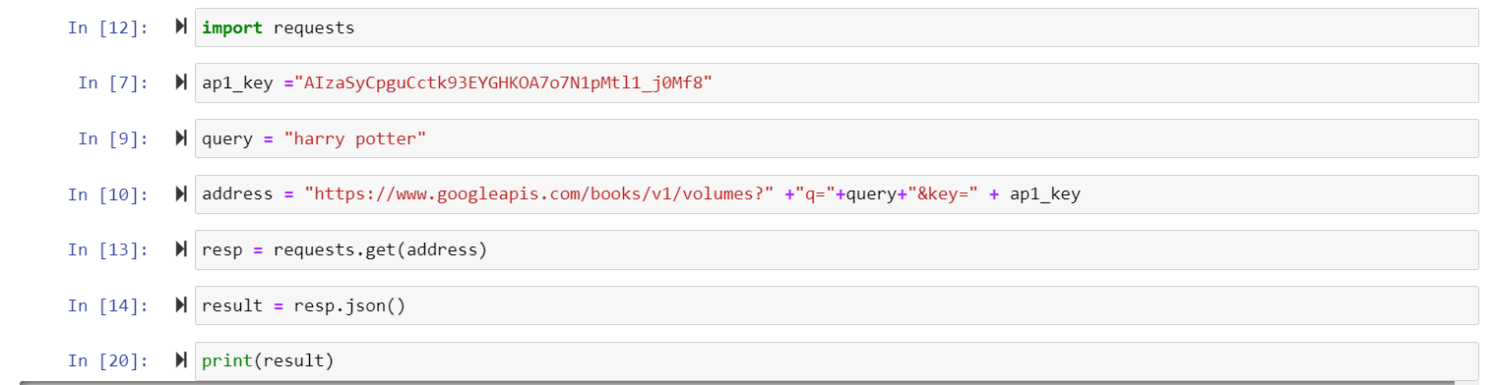
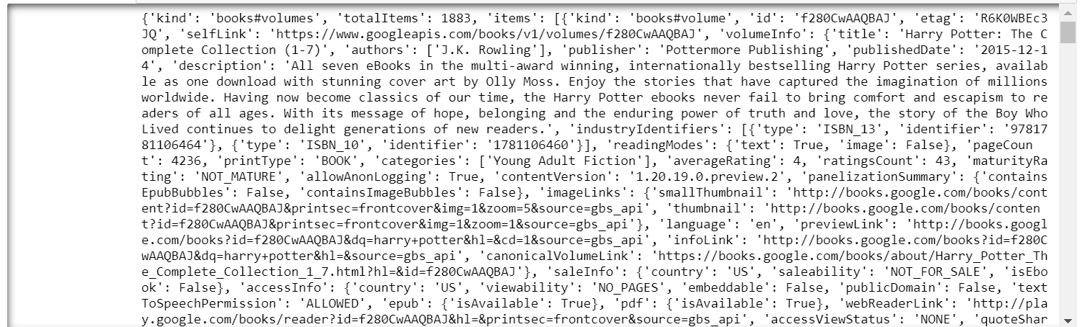
Google API Books

Slide 8
Google API Books
We are still currently working on integrating a dataset of Google API Books gathered based on the information from the IMDB Dataset.
Upon further changes are going to happen towards the end of weeks includings changes to IMDB Dataset, Google API Dataset and our integrated Dataset contains all the information for our target audience

